Slide 1
{{type=text&attribute= account_name}} Business Review Presentation

Slide 2
Agenda
Welcome & Introductions
Business Overview
What’s working well?
What’s not and why?
What are we planning to do to improve?
Business Objectives
Usage & Adoption
Support Status
Product Roadmap Updates
Action Items & Follow Ups

Slide 3
Welcome & Introductions
Account Team
{{type=text&attribute=Client Success Manager}}- Success Manager
{{type=text&attribute=Client Success Director}}- Success Director
{{type=text&attribute=Sales Manager/Director}}- Sales Manager
Technical Team
{{type=text&attribute=Client Success Manager}}- Success Manager
{{type=text&attribute=Client Success Director}}- Success Director
{{type=text&attribute=Sales Manager/Director}}- Sales Manager

Slide 4
{{type=text&attribute= account_name}}
Business Overview
General
Account Type
{{type=text&attribute=Account Type}}
Company Domain
{{type=text&attribute=Company Domain}}
Contract
Contract Value
{{type=text&attribute=Contract Value}}
Contract Start Date
{{type=text&attribute=Contract Start Date}}
Contract Renewal Date
{{type=text&attribute=Contract Renewal Date}}

Slide 5
Business Objectives
Title | Description | Created By | Updated By | Created At | Updated At
{{title}} | {{description}} | {{created_by}} | {{updated_by}} | {{created_at}} | {{updated_at}}
{{type=table&entity=objective}}

Slide 6
Usage & Adoption
Weekly/Monthly Average Usage
Start of Period: 79%
End of Period: 93%
Goal for Period: 90%
Notes:
Spoke with Mia on 3/3, she stated that new hires were being trained with focus on utilization.

Slide 7
Support Status
Q3 - Current Status
Currently Open Tickets - 12
Tickets Closed this Month – 8
2 Additional Tickets in Review or Testing
New Tickets added – 9
Area of concern – Needs Additional Investigation
Team still currently operating at 75% capacity
Action Plan Update:
New Permanent Development Resources to start by EOQ – Offer Accepted
Contract Resources Being Added to Sustaining Engineering Team Next Month
SAMPLE

Slide 8
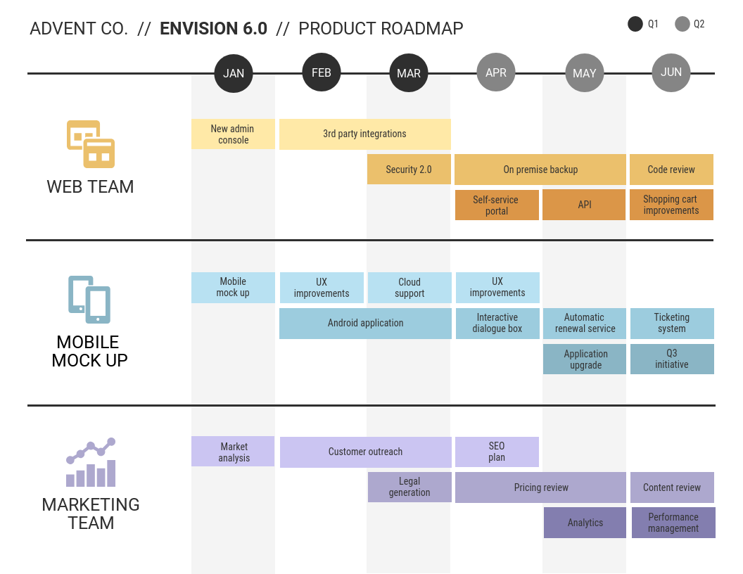
Roadmap
Highlights
On Track:
On Premise Backup
Mobile Ticketing
SCO
At Risk:
Pricing Review – Plan in Place
Performance Report - Plan Needed
SAMPLE

Slide 9
Action Items & Follow-Up
Follow Up:
Ross – Update Status on New Hire Training
Due EOM
Phoebe – Contractor Status Update for Dev Team
Due EOM
Rachel – Current Status Update on SEO Project
Due EOM
Action Item:
Joey – Schedule Next QBR with Expanded Management Team
Next Week
Chandler – Arrange Demo of new Report Builder Functionality
Next Week
SAMPLE

Slide 10
THANK YOU

